Slide 1
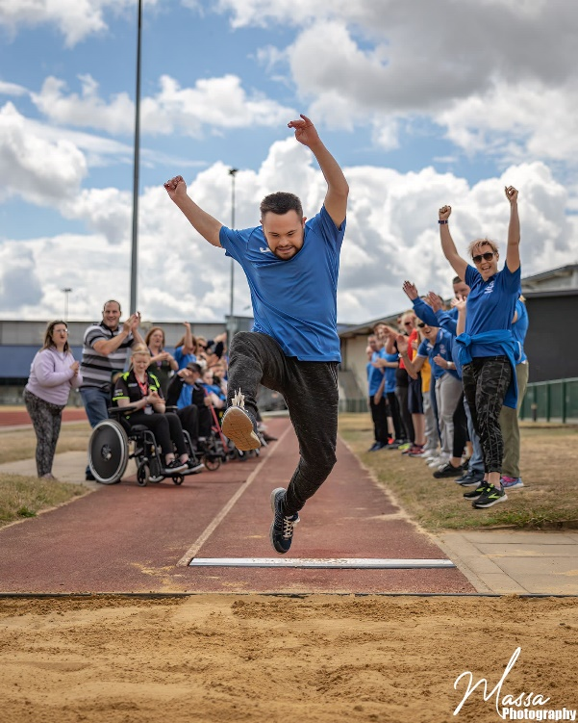
Active Norfolk & Special Olympics GB
Pilot Partnership
From 2023 & Beyond
Impact Review
Timeline: Sept 2023 to present
Athletes Impacted: 128
Volunteers Impacted: 55
Clubs Impacted: 7
Supporters/Family Members Impacted: >100
…and counting

Slide 2
Contents
01
Project Summary
02
Partnership Goals
03
Project Analysis
04
Insights & Approach – the ‘Why’ and the ‘How’
05
Impact – Testimonials, Goal Review and Social Value Return on Investment
06
Limitations, Barriers and Learnings
07
Next Steps and Funding
08
Impact Report Summary
08
Appendices

Slide 3
Project Summary

Slide 4
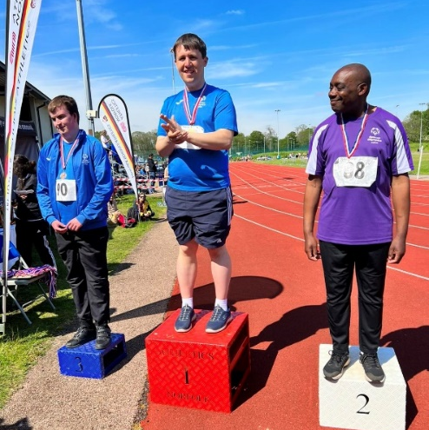
Project Summary
As is outlined in the Special Olympics GB Strategic Plan ‘Inclusion in Action’, our organisation has been striving to enhance its structure and delivery model through innovative means, including partnership work.
Sport England’s 10-year strategy "Uniting the Movement" encourages system partners to actively connect and collaborate in partnership to achieve strategic goals around equality and inclusion, which has driven the momentum of this pilot project over the last 2 years.
This focus on collaboration and co-delivery allows for mutual gain between Special Olympics GB and Active Norfolk on a strategic level right the way through to a grassroots level, fostering sustainable local impact from the perspectives of inclusive sport, health and social welfare.
The aim of this pilot has been to establish a structure in Norfolk which allows for people with intellectual or learning disabilities in the region to access safe, meaningful and fun opportunities through sport on a regular basis, with a pathway which celebrates diversity in ability, needs and individual aspirations, via an accessible delivery model of sport.
Special Olympics GB offers a pathway to unlock opportunities, and Active Norfolk has the key to accessing local structures and relationships, thus enabling this vision to be realised on the ground in a local context and driving grassroots sport and activity.

Slide 5
Context
Active Norfolk is hosted by Norfolk County Council as a mutually beneficial partnership. It is a comprehensive partnership representing those organisations who have an interest/responsibility for improved population outcomes which may be achieved through physical activity. The Active Norfolk Strategy and Impact reports outline a commitment to helping Norfolk residents lead healthy and active lifestyles. Through this partnership approach to working, both organisations have made an even greater impact and reach more people who can benefit from being more physically active.
Special Olympics Great Britain (‘GB’) is a non-profit organisation and largest provider of year-round sports training and athletic competition in summer and winter sports for children and adults of all abilities with intellectual disabilities. Special Olympics GB operates its pathway delivery across the nation via its network of 90+ accredited local clubs in line with the Inclusion in Action strategy. Special Olympics GB is part of the global movement Special Olympics International, which is the largest disability sports organisation in the world. Globally, Special Olympics reaches over 4 million athletes and participants across 207 countries. Special Olympics GB is a registered charity and a system partner of Sport England and is a part of the network of National Disability Sport Organisations.
Special Olympics Norfolk (or ‘SO Norfolk’) is a local accredited club founded in 2013 by volunteers and family members of athletes in Norfolk. Over the years, the programme has grown and evolved to reach hundreds of people across the county, and see athletes reach the national and international stages in their competitive advancement.

Slide 6




Context continued – Special Olympics Norfolk
Across Special Olympics GB nationally, there are 27 different sport pathways delivered, 18 of which are delivered in the Eastern Region of England, and 6 are delivered by SO Norfolk at the end of 2024. SO Norfolk delivers
6 sporting pathways from grassroots level, with 650 minutes of training per week
All activity spans across areas of deprivation ranging from the 1st to the 10th percentile
On average, more than 1 in 2 of athletes take part in competitions and pathways in SO Norfolk
Volunteering opportunities ranging from coaching, to committee roles, to other leadership roles – the average SO Norfolk volunteer holds more than 1 role.
There are 55 volunteers, and 128 athletes and participants registered within the Special Olympics Norfolk accredited programme. The Eastern region is the most highly subscribed region in Special Olympics GB (‘SOGB’) with over 140 volunteers and over 400 athletes and participants. Norfolk houses over a quarter of the activity in the Eastern Region in Special Olympics GB.

Slide 7
Goals

Slide 8
6 Goals to Success
01
02
03
Increased Participation and Opportunities
Enhanced Compliance, Processes & Infrastructure
Improved Volunteer Capacity, Capability & Engagement
More people in Norfolk with intellectual disabilities engaging in inclusive sports and activities.
Increased activity, accessibility, and meaningful opportunities for athletes and volunteers in Norfolk.
Higher volunteer satisfaction with roles better aligned to their skills, alongside opportunities to attract and support new volunteers. The Special Olympics Norfolk programme did not have a sustainable delivery model with its highly stretched volunteer capacity, which this project has sought to solve.
Upscaled club compliance and quality assurance processes according to accreditation standards through improved infrastructure and connected member/organisational processes.

Slide 9
6 Goals to Success (cont’d)
04
05
06
Strategic Integration
Efficiency Improvements
Best Practice Delivery Model & Sustainability
Developing a replicable and collaborative model between Special Olympics GB and Active Norfolk, with the longer term aim to enhance inclusive sports provision across England. This involves unlocking sustainable funding streams to grow and maintain the partnership.
Special Olympics GB activities embedded into Active Norfolk’s strategic priorities, such as safeguarding, facilities, education, and health.
Special Olympics GB activities embedded into Active Norfolk’s strategic priorities, such as safeguarding, facilities, education, and health.

Slide 10
Project Analysis

Slide 11
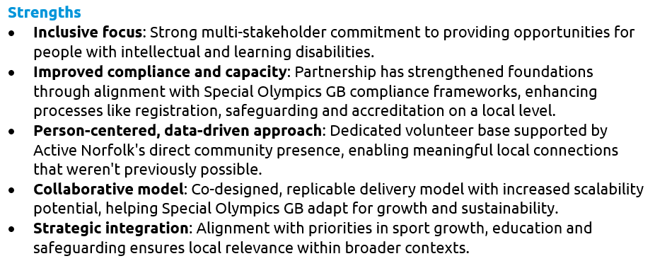

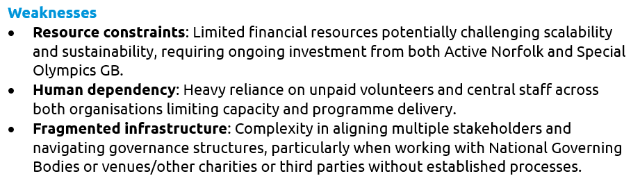


Slide 12
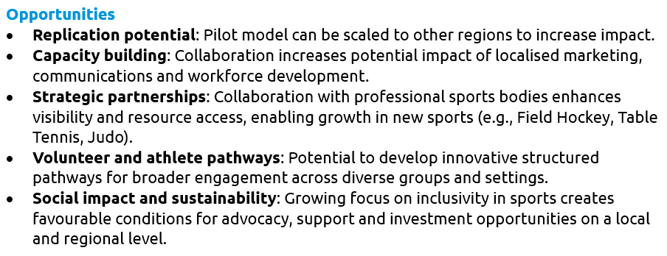

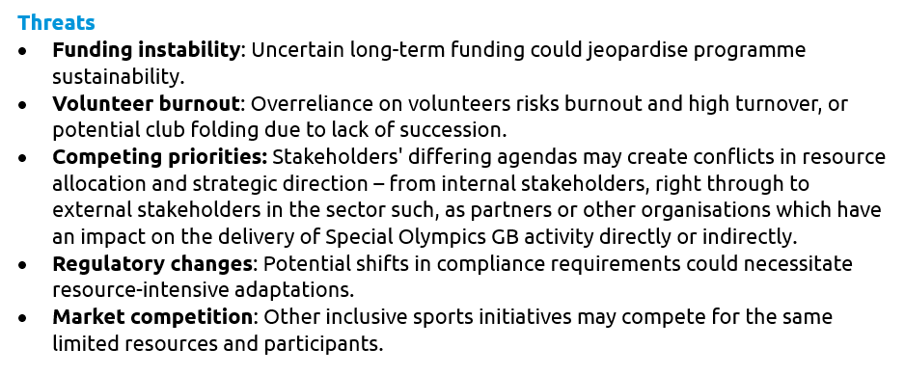


Slide 13
Insights & Approach

Slide 14
Insights
The Special Olympics GB Census in 2024 shown some striking statistics:
Almost twice as many males as females participating in SOGB Activity
The Average age of an SOGB Athlete is 31 – highlighting the importance of youth programming and connection with schools, etc. In SO Norfolk, this is 28.
69% of SOGB athletes train and compete in one sport – highlighting the opportunity for Special Olympics Norfolk to engage athletes in more than one sport.
The Average volunteer age is 55 – highlighting the challenges around recruiting younger audiences in volunteering. However, in SO Norfolk, this is 51.
The number of SOGB Athletes who hold leadership or volunteer roles is increasing but still very low – highlighting the need for more accessible pathways.
The average number of roles held by a SOGB volunteer across the nation – and in SO Norfolk - is 2.1 – highlighting the pressure volunteers hold in their capacity.
These findings emphasise the importance of strategic investment in club development, diversity initiatives, youth engagement, and volunteer support to ensure sustainable club development.

Slide 15
Why has this partnership been needed?
For the Athletes
For people in Norfolk with an intellectual or learning disability to access sport, there are numerous hidden barriers that this partnership helps to address as highlighted in insights such as the 2023 Special Olympics GB Member Survey and in the most recent Activity Alliance Disability and Activity Survey:
Over 30% of our Athletes say there are barriers to accessing support.
Barriers include: difficulties with transport and support to attending sessions regularly, having the confidence to participate, and lack of awareness about disabilities and limited opportunities.
It is key to consider the enablers for athlete participation. This includes supportive and inclusive sport structures and accessible information, informed and skilled coaches, and friends and family.
Around 20% of people with an intellectual or learning disability across the board meet the recommended levels of physical activity and exercise – and according to Activity Alliance, disabled people are twice as likely to be physically inactive than non-disabled people (41% versus 21% respectively).
From a wellbeing perspective, disabled people report a lower life satisfaction compared to non-disabled people, according to Activity Alliance recent findings.
To ensure athletes stay involved in sport, we must work on building a sense of belonging – this is found to be highly important for participants with an ID.

Slide 16
For the Clubs
Over the last 12 years, the Special Olympics Norfolk programme has experienced significant growth despite limited volunteer resources at its core. Special Olympics GB programmes are majority volunteer led, and so it is increasingly challenging for these programmes to grow without dedicated and ongoing investment.
Local grassroots clubs are operating in increasingly difficult environments, challenging growth, longevity and sustainability. Intervention became necessary to maintain the local offer for inclusive sport in Norfolk, ensuring that athletes in this region could continue to access vital sporting pathways. Some of the challenges faced on a local level included:
Higher standards: Increased compliance demands, albeit hugely beneficial and important, may often strain resources without the right support in place.
Funding competition: Professional organisations attract more funding, creating a saturated market for fundraising opportunities.
Volunteer recruitment and retention: across the sector this is increasingly challenging due to limited capacity to take on roles which are typically more demanding in disability sport
Resource access: Facilities and resources often de-prioritised grassroots activities.
Policy evolutions: Stricter regulations require more administrative effort and investment to implement and see outcomes from.

Slide 17
The Approach
Local relationship building: Active Norfolk have locally connected with organisations, clubs and communities to imbed inclusive sport into new spaces and use Special Olympics Norfolk as a tool to implement this in action.
Awareness: Active Norfolk have shown commitment to helping raise awareness of Special Olympics and the power of sport for social change across sector on a local and regional level, from strategic settings through the grassroots and community settings.
Adapting structures: Active Norfolk’s approach has been helping inform strategic direction and decision-making for structural development and evolution to create more accessible structures for clubs to access opportunities and pathways in inclusive sport and engage in existing community programmes.
Governance & responsibilities: Defining roles, responsibilities, and governance structures has ensured alignment between Special Olympics GB and local structures within sports delivery context.
Strategic integration: Align SOGB activities with Active Norfolk’s priorities in local community building, delivery of sport & activity pathways, and safeguarding.
Volunteer engagement: Create meaningful and skill-aligned roles to enhance volunteer satisfaction and retention.
Inclusive sports growth: Enhance club compliance and opportunities for inclusive sports through investment and infrastructure development.
Case-study development: Build a best-practice model from the pilot partnership.
Data and evaluation: Use insights and research to inform decisions.
Sustainability: Develop a funding plan to maintain and grow the partnership beyond the pilot phase.
The partnership approach focused on collaboration, inclusivity, and creating a sustainable model for long-term impact.

Slide 18
Impact

Slide 19
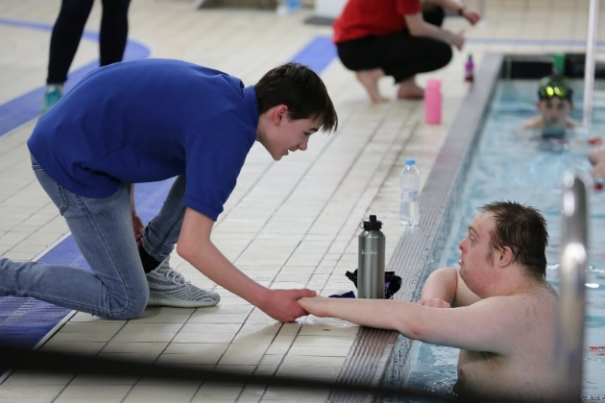
About the Project Impact
From a Special Olympics GB Membership study (2023), key motivators for athletes’ participation in Special Olympics GB activity included:
‘The love of taking part’ (81%)
‘Being the best they can be in their sport’ (64%)
‘Meeting people’/combat loneliness (81%)
‘Improving health’ (physical, social and mental) (74%)
‘Have fun’/‘Enjoy themselves’ (91%).
Furthermore, the lasting impact in taking part in Special Olympics GB goes far beyond the sport itself.
In this review, the impact of this partnership has also been measured in terms of social value and more qualitative directly from those involved in Special Olympics Norfolk activity.
We have been able to showcase:
Case-studies and testimonials from key stakeholders in the partnership
Wellbeing value return on investment in monetary value.
Statistics of success against Partnership Project Goals

Slide 20
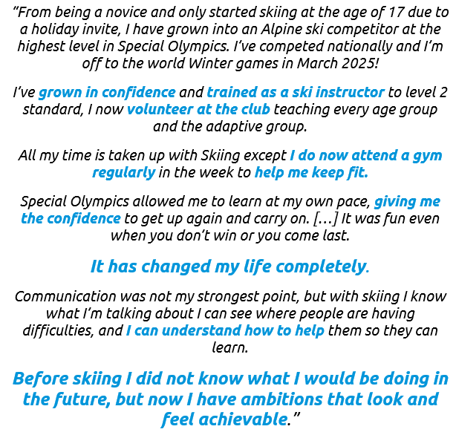
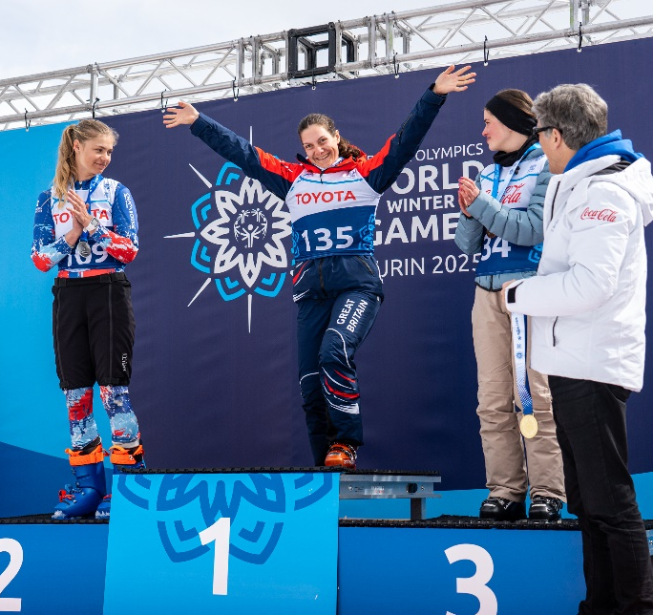
Annabelle Lamb
Special Olympics Norfolk Athlete and World Winter Games 2025 Competitor – Alpine Skiing

Slide 21
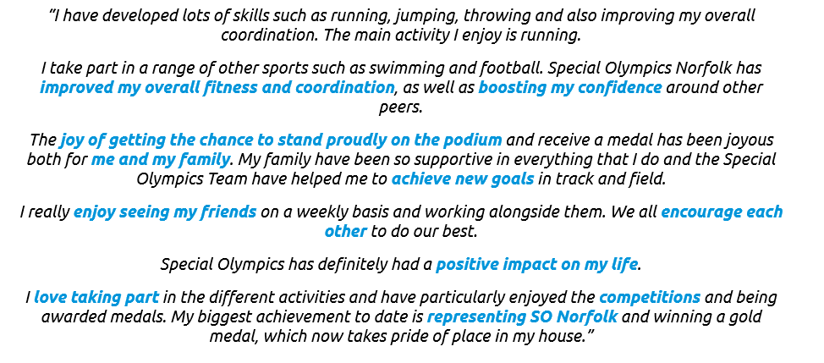
Harrison Taylor
Special Olympics Norfolk Athlete – athletics

Slide 22
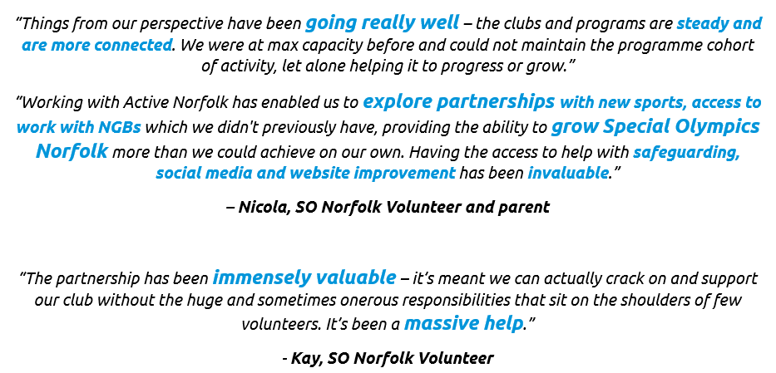


Slide 23

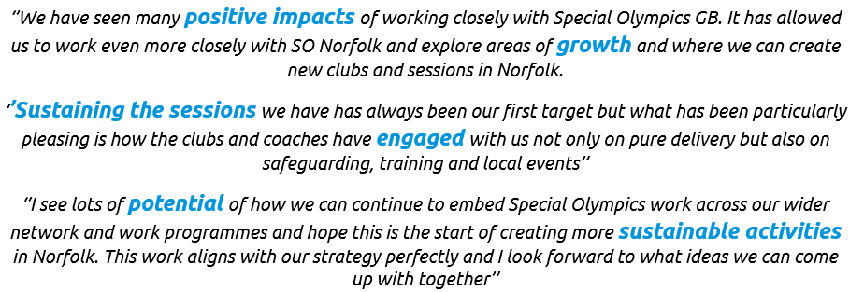
Ellen Vanlint
Senior Partnerships Officer – Active Norfolk

Slide 24
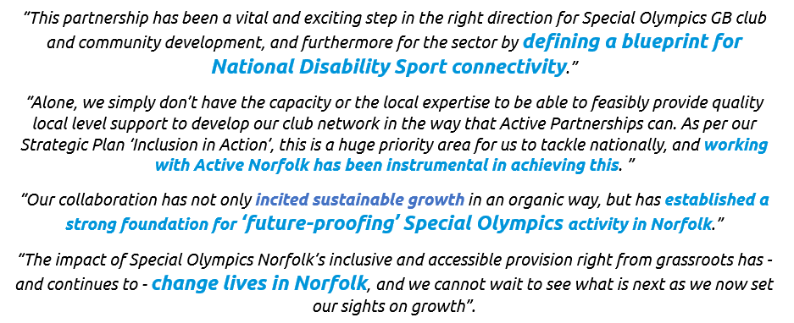
Emma Kane-McGuigan
Head of Network, Special Olympics GB

Slide 25
Return on Investment – social wellbeing value
UK Government defines social value as “all significant costs and benefits that affect the welfare and wellbeing of the population”. Through research conducted by Activity Alliance, Special Olympics GB and Active Norfolk have worked in collaboration to decipher the partnership return on investment by social value – more specifically, in terms of wellbeing value - linked with the levels of Special Olympics activity in Norfolk and the ripple effect this has on impacting athlete and volunteer quality of life. Overall, it is clear that, for people with a disability, the benefits of being active, and subsequent wellbeing benefits, are significant.

Slide 26
Social value of sport and physical activity for England estimates that sport and physical activity creates an annual social value of £107.2 billion, by relieving pressure on the NHS through the prevention of illness, reduced mental health service usage, fewer GP visits and less need for informal (unpaid) care.
In partnership with State of Life, Sheffield Hallam University and Manchester Metropolitan University, Sport England’s research measured two types of social value: the primary direct value to individuals through improved wellbeing (being happier and healthier); and the secondary wider value to society, such as savings made to the public purse.
Wellbeing value (WELLBY) is the monetary value that can be placed on happiness, health and life satisfaction. Active adults, who do more than 150 minutes of physical activity a week, enjoy the greatest wellbeing value – the equivalent of £2,500 per person a year, compared to inactive adults.
For more information see HERE and Appendix 1.
About Social Value & Wellbeing Value
Sport and physical activity creates annual savings of £10.5 billion for the NHS and social care, according to Sport England research published in October 2024.

Slide 27

Key Findings
Research conducted by Activity Alliance reveals that:
The wellbeing benefits of physical activity are at least three times greater for disabled people compared to non-disabled people
Regular volunteering enables participation opportunities and significantly boosts the wellbeing of volunteers contributing significant social value.
In England, the current physical activity levels of disabled people generate approximately £35.9 billion in social value
For Norfolk specifically, this estimated value is £572 million (based on Sport England's Adult Active Lives Survey)

Slide 28

Exceptional Return on Investment
The national average shows that £1 spent on community sport and physical activity generates over £4 for the English economy and society – see here for further information.
However, the Special Olympics Norfolk partnership demonstrates a remarkably higher return with regards to wellbeing value, estimating approximately £45 in wellbeing value for every £1 invested within the initial 1-year £10,000 project and subsequent rolling investment since surpassing the 1-year mark. This totals a wellbeing value return on investment of over £450,000.
This calculation is based on conservative estimates of activity levels, suggesting the actual return may be even higher, particularly in settings with moderate to high activity levels (such as swimming).
The calculation includes:
Values assigned to athletes and participants based on the frequency and intensity of their physical activity
Values assigned to volunteers based on their frequency of attendance
Consideration of both direct participants and the ripple effect on families and communities

Slide 29
Implications
The significant wellbeing value demonstrates that:
Increased investment in the partnership directly correlates to greater impact
More investment enables the strengthening and growth of opportunities, benefiting more individuals
Volunteers and family members of participants also experience wellbeing benefits
The partnership's awareness-raising activities increase the likelihood of more organisations offering inclusive sporting opportunities

Slide 30




Beyond Financial Metrics
While this monetary value is measured primarily through time and frequency of sport participation, this impact review overall highlights that the full impact extends to:
Improved mental wellbeing
Enhanced access to employment and further learning/ development opportunities
Increased social connectivity
Greater independence and confidence

Slide 31
What does this mean?
Through the provision of local inclusive sport and activity in Norfolk through this partnership, individuals with an intellectual or learning disability are increasingly likely to be able to access meaningful and inclusive sport and physical activity, more often, and to a greater scale which improves their wellbeing.
s
The more investment in this partnership, the more opportunities can be strengthened and grown, meaning that more individuals will feel real impact of this value. This is equally the case for volunteers, and for family members of participants and athletes, who are statistically often involved in regular volunteering activity in Special Olympics GB. Additionally, with the partnership increasing awareness and reach, the likelihood of more organisations offering inclusive sporting opportunities is increased, leading to again more participation.
s
Therefore, in summary, increased investment = increased wellbeing impact.
s
This testifies to the profound impact of sport and physical activity on our overall quality of life. While the analysis cannot unpack all the ways sport and physical activity improves wellbeing, this value likely captures the sheer enjoyment of being active, benefits to physical and mental health, and knock-on impacts for other aspects of life such as relationships, social connection, and work.

Slide 32
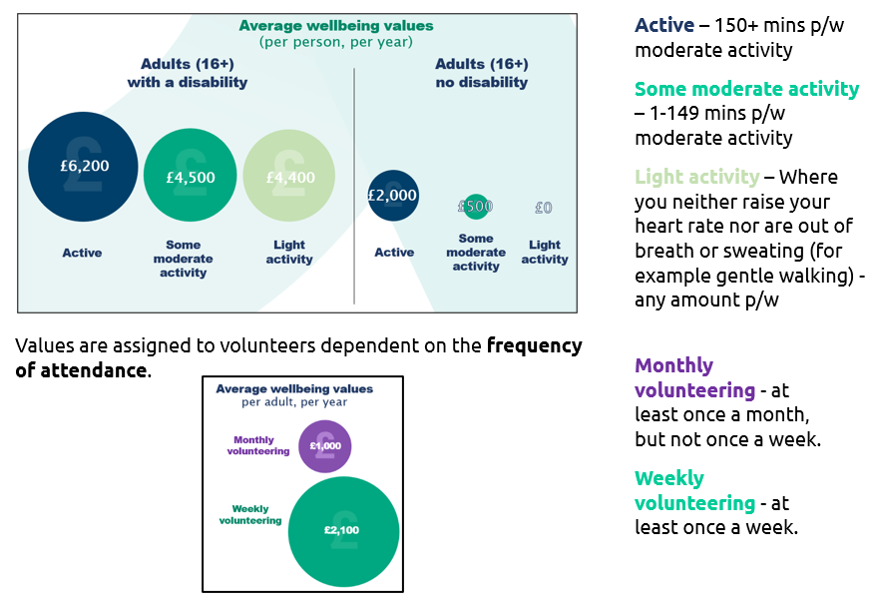
What does this mean – Visual Representation

Slide 33
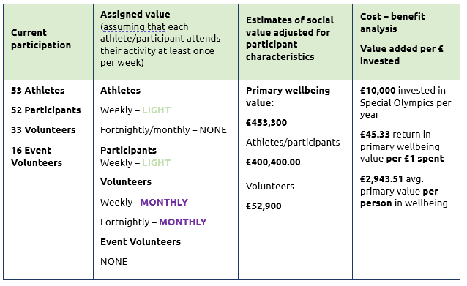
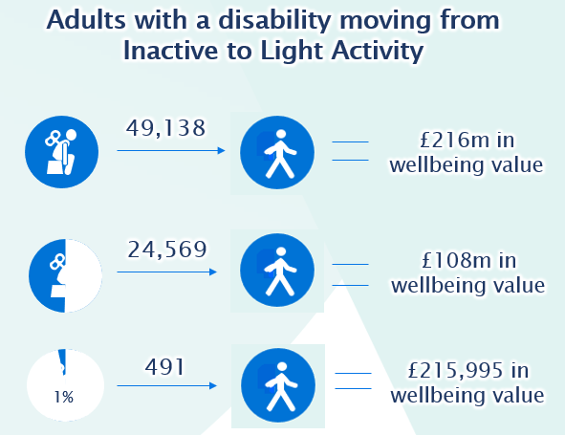
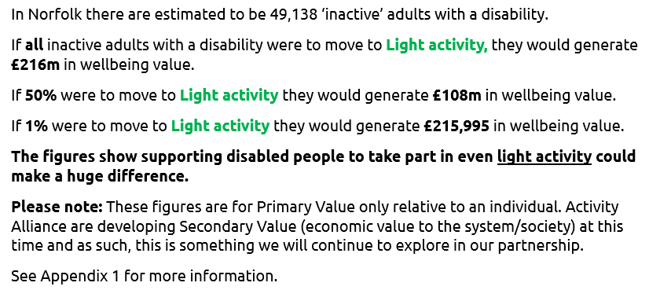
What does this mean – Visual Representation

Slide 34
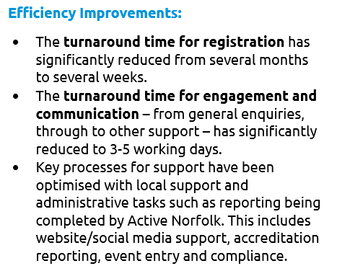
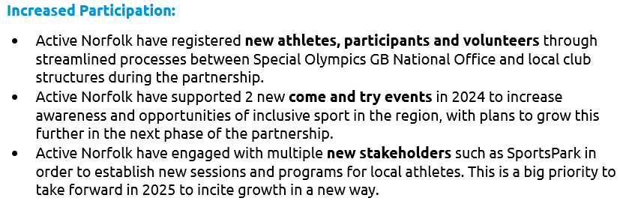

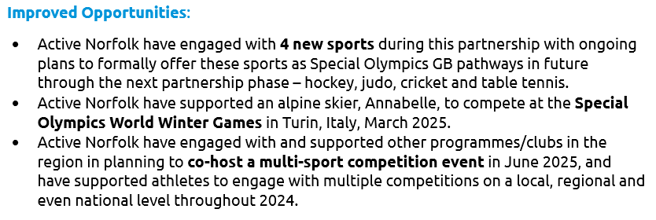

Statistics & Successes

Slide 35
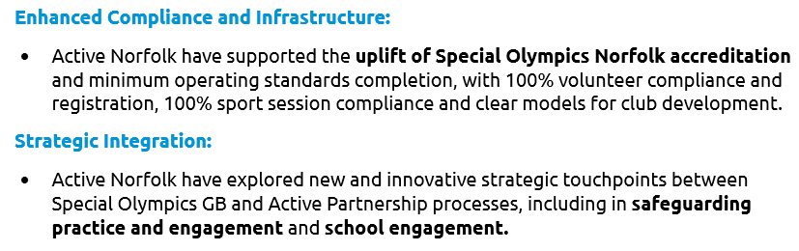



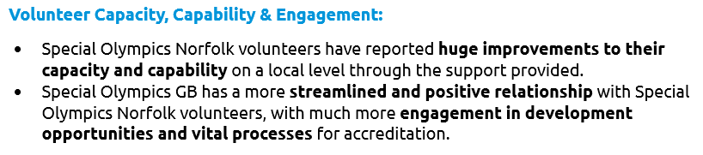

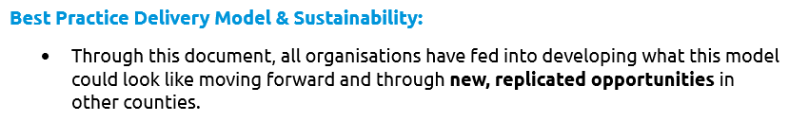
Statistics & Successes

Slide 36
Limitations, Barriers and Learnings

Slide 37

Limitations
This pilot partnership has not been without its limitations which highlight potential obstacles that required proactive strategies and solutions to combat.
Special Olympics GB and Active Norfolk have been successful in mitigating such limitations through the efforts of their partnership, but more time and resource is needed to take the next step and see sustainable and self-sufficient local structures set up for success.
See next some of the limitations identified and mitigation strategies.

Slide 38
Limitations
Compliance Challenges: Ensuring all clubs are equipped to meet safeguarding and accreditation standards across the local programme.
Mitigation: Active Norfolk took responsibility for implementing and enforcing Special Olympics GB Accreditation processes at local level, supporting clubs with these processes.
x
Resource Constraints: Limited human and financial resources potentially hindering ability to scale or sustain the initiative.
Mitigation: Active Norfolk alleviated volunteer resource constraints by supporting local clubs with administration, development, awareness-raising and guidance interpretation.
x
Volunteer Recruitment and Retention: Difficulty attracting and retaining volunteers, particularly for specialised roles.
Mitigation: Active Norfolk supported volunteer administrative processes to improve the volunteer journey, with scope for further assistance in wider recruitment.
x
Reach and Engagement: Challenges expanding participation among athletes and volunteers, especially in underserved areas.
Mitigation: Active Norfolk leveraged its position to connect Special Olympics GB clubs with schools and local organisations, supporting local marketing with potential for further development.
x
Sector Challenges: External factors including policy changes, funding competition, and economic pressures impacting progress.
Mitigation: Active Norfolk provided local support, resources and guidance regarding policies, processes and sector connections.
x
Integration Barriers: Difficulty embedding Special Olympics GB activities into local structures and aligning with Active Norfolk's strategies.
Mitigation: Active Norfolk advocated for the Special Olympics movement across the county, helping integrate its vision into other contexts and unlock opportunities for wider participation.
x
Sustainability: Securing long-term funding and support beyond the pilot phase.
Mitigation: Both organisations are pooling internal resources to explore all avenues for financially sustaining the partnership.

Slide 39


Learnings
The pilot partnership project between Special Olympics GB and Active Norfolk has set a benchmark for the development of inclusive sport in Norfolk.
The partnership has laid the foundations to unlock the expansion of inclusive sports opportunities in Norfolk, increasing participation among individuals with intellectual disabilities and enhancing club compliance and local infrastructure. It has improved volunteer satisfaction through meaningful local level support systems and fostered stronger partnerships between Special Olympics GB and local organisations in Norfolk, as well as setting up Special Olympics GB to be able to grow in a sustainable way. Lastly, it has developed a replicable delivery model for broader implementation, embedded Special Olympics GB activities into local strategies, and generated insights to help this with future projects and opportunities.

Slide 40

Learnings explained
Athlete Leadership and Voice – the partnership will seek to imbed athlete voice and leadership into activities to ensure actions reflect their needs an aspirations.
x
Risk Management – the partnership will need to address further and ongoing challenges around compliance including safeguarding, member registration, etc.
x
Resource focus – the partnership needs a focused and concise focus for the next phase to see accelerated impact.
x
Story-telling – the partnership needs to continue to prioritise sharing amazing stories about the impact it has on a local level.
Growth Capacity – the partnership is ready to unlock the growth potential identified through the first phase of this partnership, and so prioritisation is key.
Measuring success – the partnership will seek to impose specific metrics to showcase success and impact based on priority focus area. This will also include documenting information that will help share knowledge for future replication.
Partnership Growth – the partnership will explore and prioritise local and regional partnership opportunities to enhance outcomes, such as governing bodies of sport, schools and local venues/ leisure centre providers.
Funding – the partnership needs to secure additional funding to continue, preferably for beyond 1 year as to ensure longevity and continue the amazing momentum built in its first phase.

Slide 41
Next Steps and Funding

Slide 42
Plans for the next phase of this partnership aim to further increase participation of both volunteers and athletes through innovation and new structures/sports and partnership activity on a local and regional level.
Before now, Special Olympics Norfolk has not had the infrastructure to unlock sustainable growth, and as such, the following actions will be prioritised to achieve this:

Slide 43

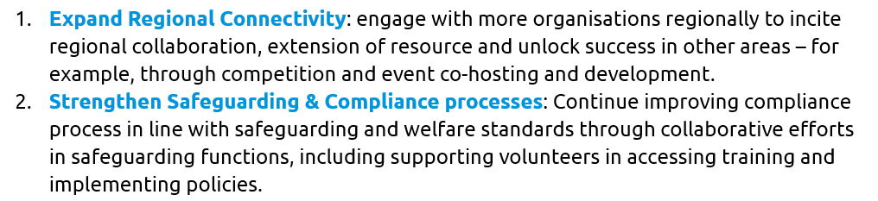

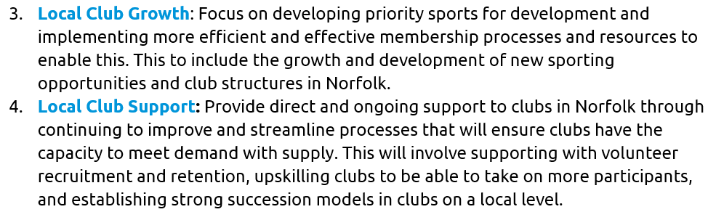

Next Steps

Slide 44
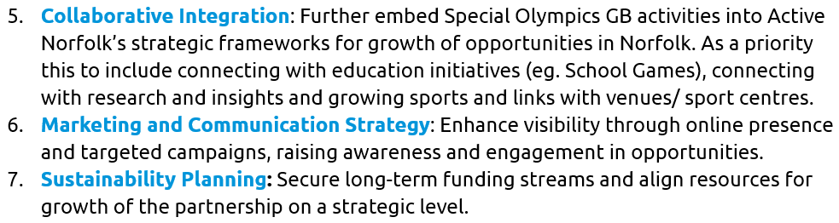


Next Steps

Slide 45

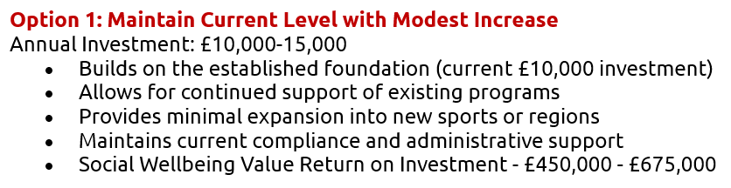
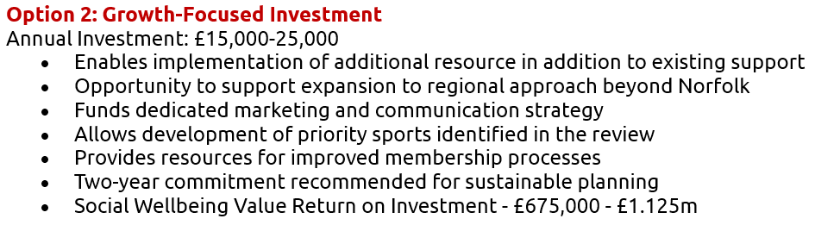
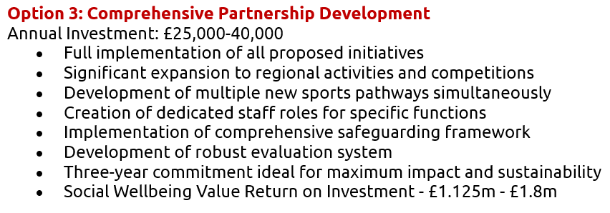
Funding
For the partnership to sustain, funding is essential. The funding model is scalable as shown.
The document highlights that for every £1 invested in this partnership, approximately £45 of wellbeing value is generated. This exceptional statistic strengthens the case for higher investment levels, particularly given the significant impact on wellbeing for people with intellectual or learning disabilities.
For sustainability, a multi-year funding commitment (minimum 2 years) would provide the stability needed to implement long-term strategies and address the sustainability concerns identified in the limitations section.

Slide 46
Impact Report Summary

Slide 47
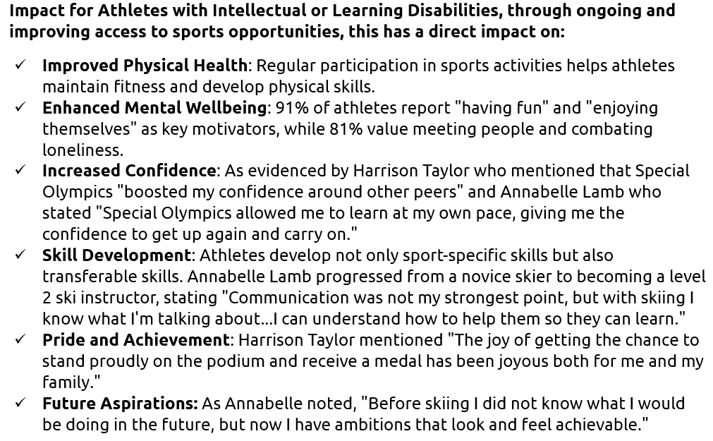
Summary

Slide 48
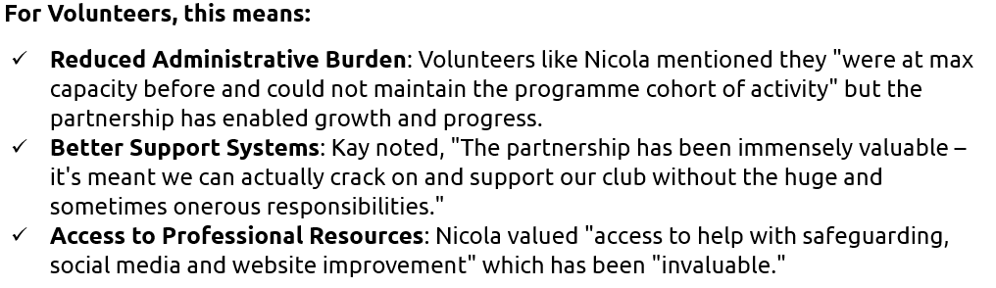
Summary

Slide 49
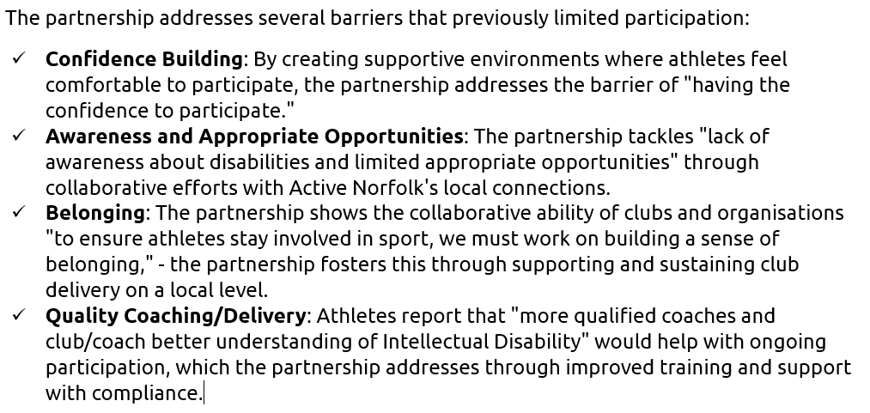
Summary

Slide 50
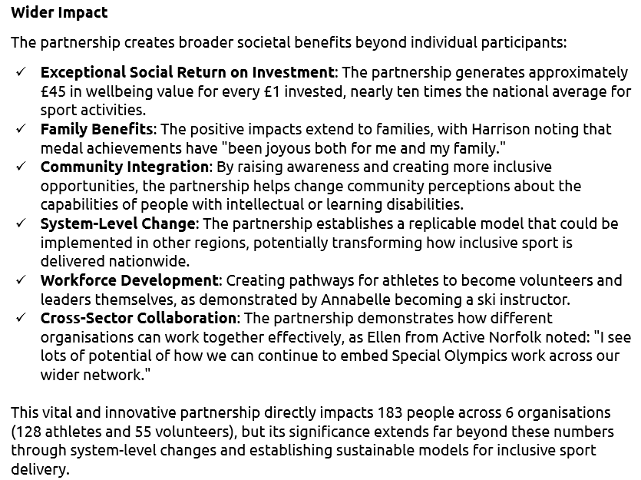
Summary

Slide 51
Appendix

Slide 52
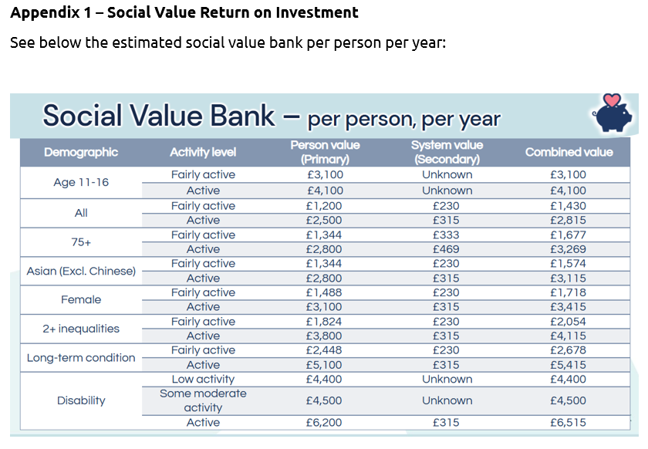
Explanation of Social Value and Wellbeing Value
What is a WELLBY, what is it worth and is it real money? — State of life

Slide 53
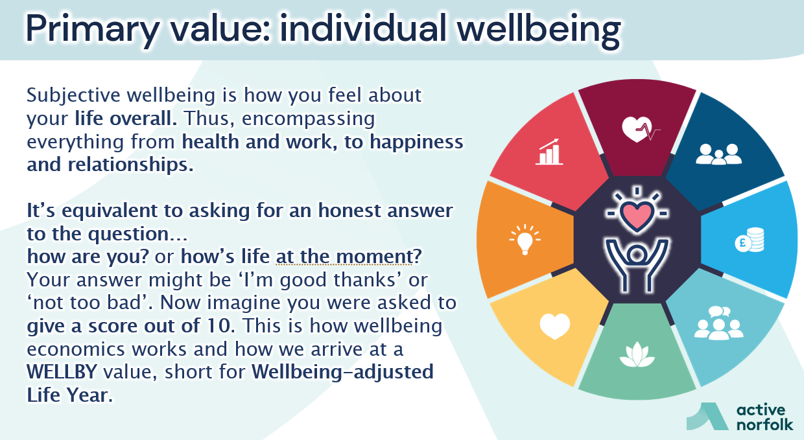
Explanation of Social Value and Wellbeing Value
What is a WELLBY, what is it worth and is it real money? — State of life

Slide 54
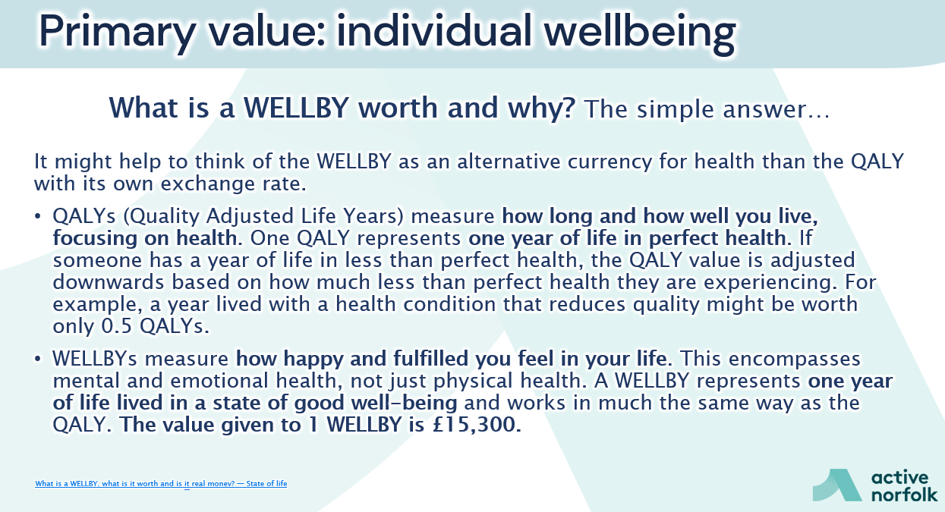
Explanation of Social Value and Wellbeing Value
What is a WELLBY, what is it worth and is it real money? — State of life

Slide 55
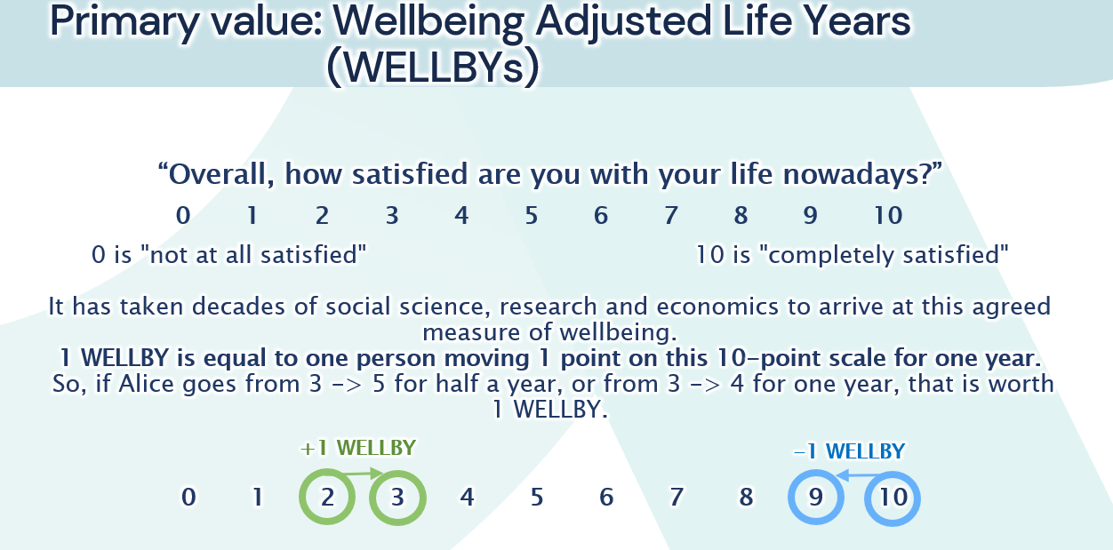
Explanation of Social Value and Wellbeing Value
What is a WELLBY, what is it worth and is it real money? — State of life

Slide 56
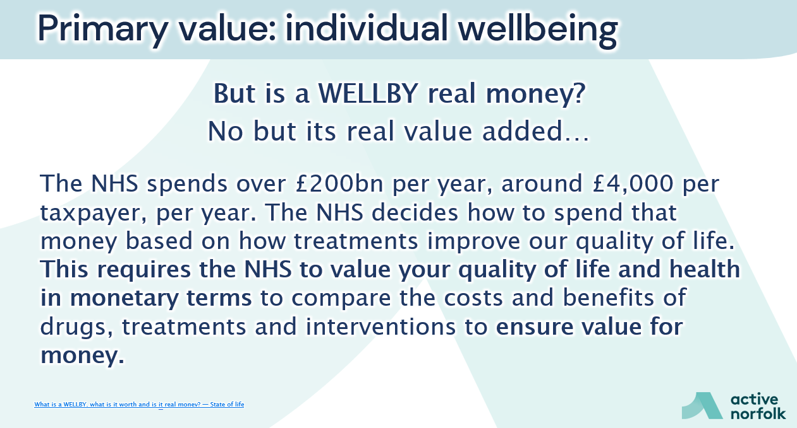
Explanation of Social Value and Wellbeing Value
What is a WELLBY, what is it worth and is it real money? — State of life

Slide 57
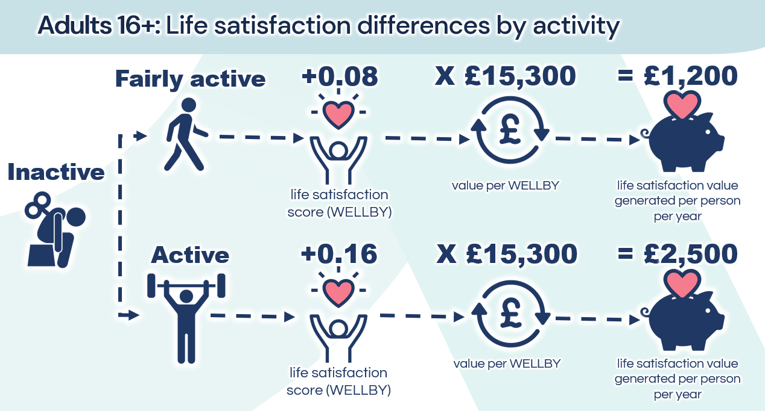
Explanation of Social Value and Wellbeing Value
What is a WELLBY, what is it worth and is it real money? — State of life

