Slide 1
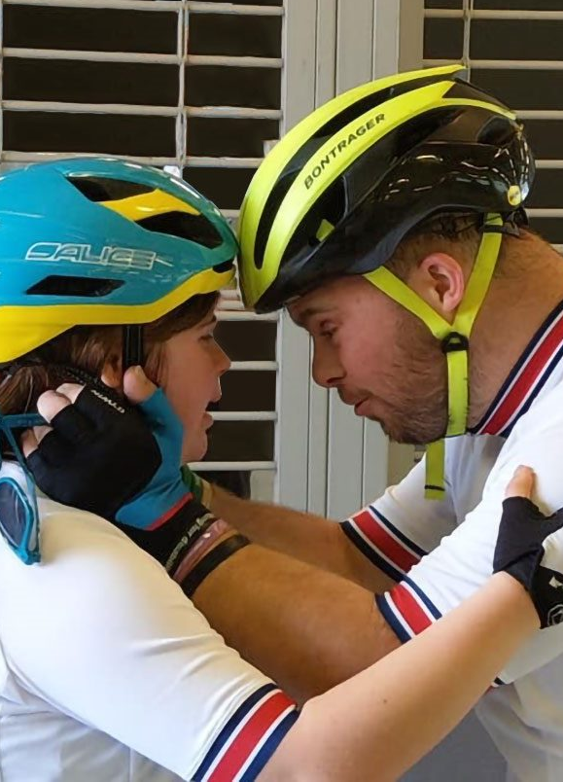
Accreditation Membership Webinar
October 2025

Slide 2




Accreditation: what does it achieve?
01
02
03
Establishes
Infrastructure
Ensures
Compliance
Unlocks
Development
Volunteer Roles
Sessions & Delivery
Accreditation Agreement & Governance
Special Olympics Rules & Requirements
Safeguarding
Min. Operating Standards
Pathways – athletes
Pathways – volunteers/coaches
Growth & Innovation – Clubs
Leading to
Sustainability
Leading to
Quality
Leading to
Impact
Notes:
Accreditation is essentially the organisation’s way of achieving a Risk Review and a Quality assurance process all rolled into one – this may seem very technical jargon but what that essentially means is that SOGB promotes its aversion to risk and enthusiasm for quality sports delivery through its accreditation provision in our delivery model. This is similar in a lot of ways to, for example, NGB affiliation processes, but due to the nature of our organisation this does look ever so slightly different.
A number of key factors feed into accreditation as you’ll see on the screen, from mandatory volunteer roles, sports training structures, and through to governance, to ensure strong infrastructure and therefore sustainability of both a club and of the organisation. As well as this, there is of course compliance to assure quality and the adhering to requirements which externally influence our processes, and then all of this leads to development, as we cannot develop without a strong foundation. The development of pathways for example for coaches, cannot exist without a compliant coaching base within a strong and stable environment to do the coaching.
The key message we want to get across in this session is that we are here to support you on this journey to establishing (or in many cases, sustaining) infrastructure, withing your clubs through accreditation, to ensuring compliance and to ultimately unlocking development. As you will all know much better than I, these are 3 areas clubs need in order to thrive and without accreditation, Special Olympics delivery cannot exist.

Slide 3













Accreditation Compliance & Minimum Operating Standards – where do they come from?
Notes:
We get asked a lot about the why behind certain things when it comes to accreditation requirements – whether it be volunteer registration, DBS/PVG, coaching rules, reporting numbers and session info/risk assessments and more. On the screen you will see some examples of organisations who feed into our minimum operating standards due to the nature of our organisation – SOGB is a registered charity, an international sub-program of SO, a National Disability Sport Organisation and Sport England System Partner, and so we must adhere to certain rules and regulations which then feed through to you as an accredited club with SOGB as you are delivering SOGB activity. Not only does this ensure that clubs and programmes are operating safely and to a high quality, but it ensures a degree of alignment across the organisation’s delivery with regards to the likes of SOI rules and regulations and those across the sector relevant to our sports. Lastly but certainly not least, much of our requirements – particularly around governance - are also in fact legal requirements as a charity, and can relate directly to insurance coverage as well when it comes to delivery and compliance.

Slide 4
Accreditation: what do we ask of you?
Immediate Actions for Clubs (Nov-Dec 2025)
Review personalised Accreditation Information Summary
Address any identified compliance gaps
Submit outstanding mandatory documentation (as per your club summary documents)
Key Points to Note
If Fully Compliant: No action currently required
If Updates Needed: Use online forms for:
Member information changes
Session updates
Volunteer registrations
Risk assessment submissions
Further Actions for Clubs:
January-February 2026
Monday 19th January- request for financial returns
End of February- accreditation confirmations issued, Find a Club page updated
March 2026
W/C 2nd March- accreditation agreements sent to clubs
W/C 2nd March- accreditation invoices sent to clubs
End of March- agreements signed and invoices paid

Slide 5
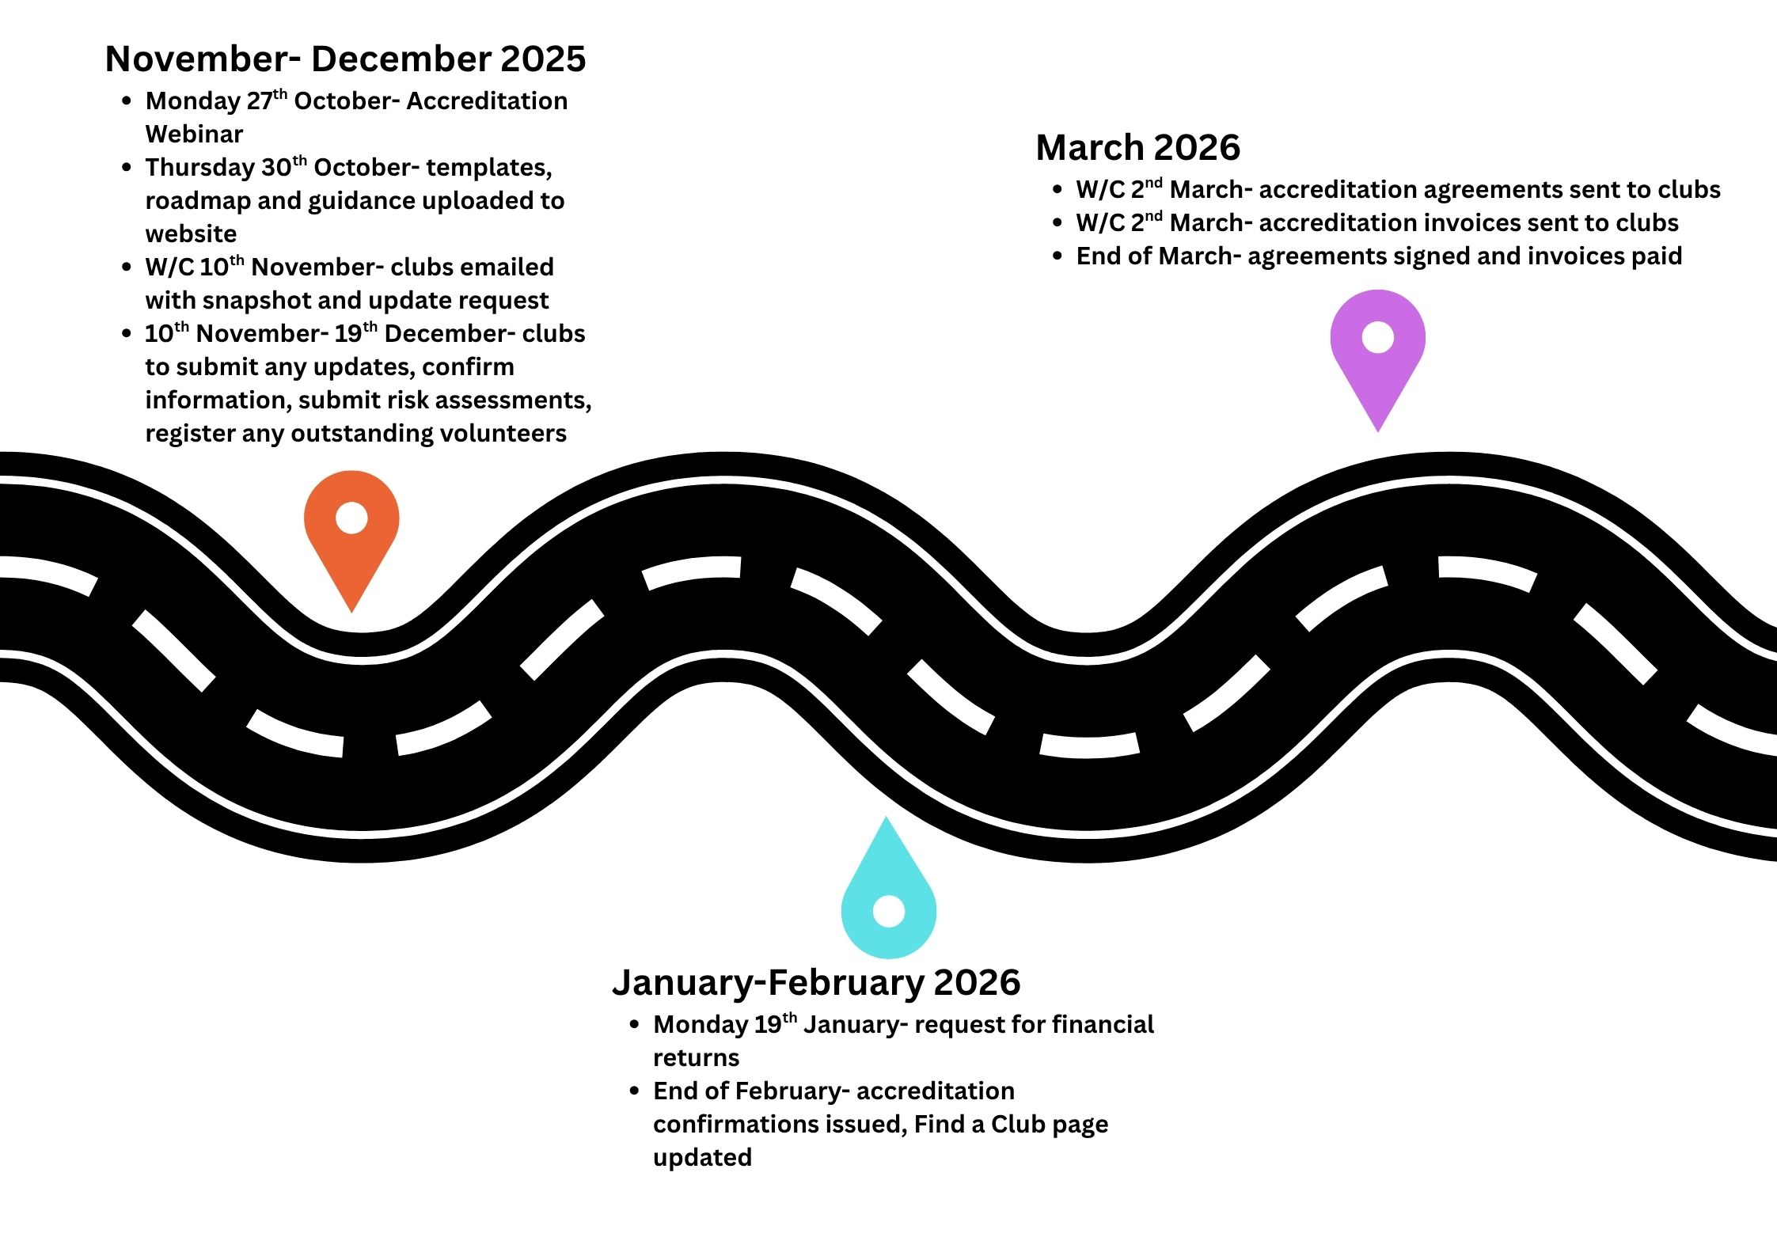
Accreditation roadmap
Notes:
Roadmap recap – a reminder about our roadmap and what the process looks like for you this year. This roadmap is found in our FAQs document on the website but if you have any questions on this please be in touch.

Slide 6



Accreditation: what do we do with the data?
Update our central data base
Produce reports such as SO Annual Census
Ideas and insight into where development is needed
Strategic planning
Celebrate good practice
We are happy to feedback anything you're interested in with regards to your region
Notes:
You might ask what is it SOGB does with our information. We utilise a central highly protected database named Salesforce in order to manage your data securely and safely whilst fulfilling our requirements as an organisation whether it be for insurance, audit, compliance review, SOI Annual Census, strategy, development/support, member communication or of course celebration. If you ever have any questions about this please do be in touch.
Something key to note is that we do sill use active member registers for club communication only of membership information – for example, athlete/ volunteer lists. It’s our aspiration to improve and enhance this process in future but currently we review these documents sent to us directly by clubs and ensure it matches up with our database centrally.

Slide 7
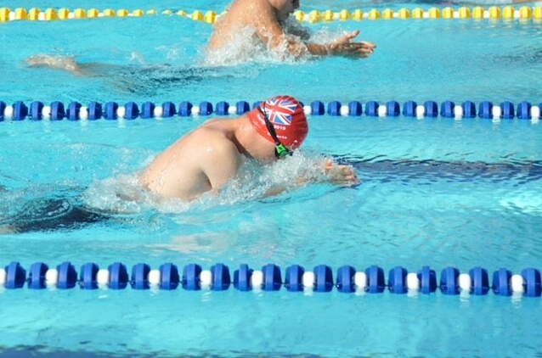
Example: SO Swim Club Updates
Current Situation:
Successfully accredited club from previous year
New changes:
5 new athletes joined
Added Tuesday evening training session
New head coach (Sarah) for new session
New assistant coach (James) for support
Current Situation:
Successfully accredited club from previous year
New changes for current year:
5 new athletes joined
Added Tuesday evening training session
New head coach (Sarah) for new session
New assistant coach (James) for support
Updates needed:
Update club AMR- for coaching staff (volunteers) and athletes
Ensure both athletes and volunteers individually registered through SOGB relevant online forms
Athlete: HERE
Volunteer: HERE
Complete session information update form, adding risk assessment: HERE

Slide 8
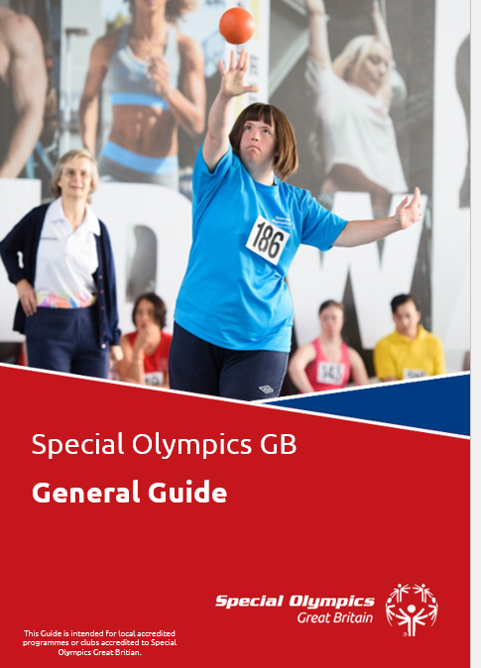
Club Development
Club Information Pack- still under development but lots of helpful information
New finance and fundraising section in quarter one of next year
General club resources:
https://www.specialolympicsgb.org.uk/club-resources/programmes
Volunteering section: all new guidance uploaded separately in volunteering section of website resources page

Slide 9
Accreditation Walkthrough

Slide 10
Questions

Slide 11

Accreditation:
what do we want for the future?
Notes:
Accreditation and Network Development Update
SOGB is making significant progress in streamlining our accreditation processes and implementing our Network Structure Strategy, directly responding to member feedback. Following extensive consultation since 2022, we heard clearly that accreditation needed to be simpler, with less duplication, pre-populated forms, better guidance, and tailored processes for different organisation types such as NGBs, schools, and regional committees. We are now delivering on these improvements through our three-tier model (Governance, Development, and Delivery), which is being rolled out from 2025-2027. This includes establishing home nation legal entities, enhancing regional committee structures, and creating thematic development groups focused on areas like competition and volunteering. At the local level, we're piloting bespoke accreditation pathways with National Governing Bodies including Table Tennis, Judo, Hockey, and Skating, as well as developing streamlined processes for schools through programmes like MATP and Unified Champion Schools. We've also created comprehensive resources and templates available on our website to support you through these changes. Ultimately, our goal is to make accreditation easier and more accessible, reduce administrative burden, and ensure you have the information and support you need when you need it.

