Slide 1
Special Olympics GB
Safer Recruitment

Slide 2
What do we mean by Safer Recruitment?
Safer Recruitment is the general term used for practices and processes that organisations use to ensure they are keeping dangerous people away from vulnerable children and adults. Safer Recruitment is a crucial part of the safeguarding process and covers everything from job descriptions, shortlisting, background checks, references, interviewing and induction and probation periods.
There is national legislation that places the responsibility and management of safer recruitment onto organisations themselves meaning we have a legal obligation and duty to ensure we have sector standard safer recruitment practices in place.
The primary piece of national legislation that talks about safer recruitment is “Keeping Children Safe in Education, 2018”. While initially aimed at education provisions working with children, the legislation in its latest review and update now references any organisation that works with and has care of children.
In addition, and with backing from the Ann Craft Trust, National and Local Adult Services and the DBS Service this now extends to those working with Adults with additional vulnerabilities.
At SOGB we work with children and adults who are considered to have additional vulnerabilities due to their disability and therefor it is vital that we are following robust safer recruitment practices.

Slide 3
Statistics
In there UK there are:
64,684 people on the Adults Barred List
82,799 people on the Children's Barred List
93,653 people on both Barred Lists
In 2023 there were 26,299 child abuse convictions recorded by the police in England and Wales
There were 173,280 section 42 enquiries into adult abuse
Over the last 4 years there has been a total of 3,129 cases managed by 39 NGBs across the sports sector that required some form of external referral such as, with a Local Authority Designated Officer (LADO), adults and/or children’s services or the police
14% of people with a disability will face abuse vs 6% of people without a disability
SOGB athletes are significantly more at risk of experiencing abuse as opposed to athletes without a disability. This is why it is vital that we do everything we can to ensure safe working environments for our athletes, we must go above and beyond what other NGB’s are doing.
We have a duty to protect our athletes from harm and abuse and will implement the most robust measures we can, to ensure protection for all.

Slide 4
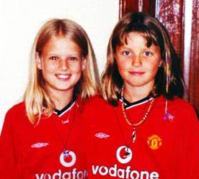
Why do we need to do it?
Failings highlighted in a high number of serious case reviews into significant safeguarding cases which resulted in the deaths and/or serious abuse of a children and adults at risk showed that many of the perpetrators of the crimes were already known to services and that in many cases held convictions and warnings in relation to the abuse of vulnerable people.
Many of these reviews stated that if safer recruitment checks were completed to a satisfactory level, the lives of these children and adults could have been saved and cases of significant abuse could have been prevented.
The case of two 10-year-old girls, Holly Marie Wells and Jessica Amiee Chapman who were murdered by their school caretaker Ian Huntley prompted an overhaul of safer recruitment processes nationally and serve as a bleak reminder of why this is so important.

Slide 5
The issue within Sport

Slide 6
The Picture at Special Olympics
During the Berlin World Games 2023, the SOI Safeguarding Team handled 43 safeguarding reports which included:
8 cases which involved Delegation Coach misconduct towards athletes
4 cases which involved Delegation Coach misconduct towards volunteers
5 cases of Event Volunteer misconduct towards athletes
6 cases of event volunteer misconduct towards other volunteers
The SOGB Safeguarding Team has handled 30+ Safeguarding Cases over the last two years.
A number of which have resulted in permanent expulsion from all SOGB activity and referrals to the DBS barring list for both adults and children.
In some cases, the alleged perpetrator was already known to services and had convictions.
DBS checks for some of these were not in place due to them not being registered in the correct roles.

Slide 7
The Law and Legislation
Child DBS Guidance states that;
Anyone employed to be a coach or instructor of children’s sports whose duties include teaching, training, or instructing children, or providing advice or guidance to children relating to their physical, emotional, or educational well-being, is eligible for an Enhanced child workforce DBS check.
If more this activity occurs on more than 3 days in any period of 30 days, or once overnight between 2am and 6am with the opportunity for face-to-face contact with children with a Children’s Barred List check.
Adult DBS Guidance states that if you provide;
a) any form of care or supervision;
b) any form of treatment or therapy;
c) any form of training, teaching, instruction, assistance, advice or guidance provided wholly or mainly for adults who receive a health or social care service
You would be required to have an enhanced adult workforce DBS check.
“Regulated activity” for adults is categorised as providing;
Health care
Personal care
Social work
assistance with general household matters, for example managing a person’s cash
Assistance in the conduct of personal affairs
conveying a person (includes drivers or assistants who transport an adult due to their age, illness or disability)
Scottish Legislation
PVG Scheme Individuals and Clubs
From the 1st July, you will be breaking the law if you;
Work in a regulated role without PVG membership or;
recruit someone into a regulated role if they are not a PVG member

Slide 8
How do we do it?
What are we aiming to achieve?
Deter - to stop unsuitable people from applying for a position. Sending out clear messages in job advertisements that your organisation has strict recruitment policies in place to protect children, young people and adults at risk
Prevent and Reject - unsuitable people lie to get close to vulnerable people, any details they give must be checked, cross-referenced and applicants screened
Identify and Reject - follow up with a rigorous induction and probation period to check the right person has been appointed. Continue to train staff and promote a safe culture within your organisation.
Job/Role Descriptions
(Available on the SOGB Website)
Identification verification
Request a minimum of two references
(Completed centrally by SOGB)
Request a CV and explore any gaps in work history
(Completed centrally by SOGB)
Interview Questions
Criminal Background Checks (DBS/PVG)
(Completed centrally by SOGB)
Probation Periods/Performance Review

Slide 9
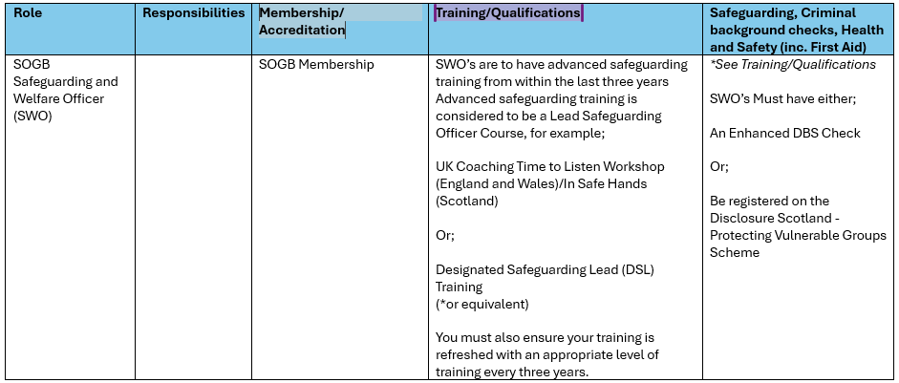
Our Resources
Volunteer Reference Request Form
DBS Eligibility Guidance
DBS Policy
Standards for Deployment (Draft)
Recruitment of
ex-offender statement
Adverse DBS Disclosures
Process

Slide 10
Next Steps
Your Questions…
We have Safer Recruitment processes outlined in section 9 of our Safeguarding and Welfare Policy which staff need to be following when managing the recruitment of staff and volunteers.
Questions..
Would some key info pulled out from the policy, be useful?
Should this information be built into the onboarding process?
Would some examples of safer recruitment questions for potential new volunteers be useful?

